Slide 1
Optical Instruments
Notes:
上册P97）3，4，5

Slide 2

Optical Instruments
Analysis generally involves the laws of reflection and refraction
Analysis uses the procedures of geometric optics
In certain phenomena, the wave nature of light must be taken into account.

Slide 3
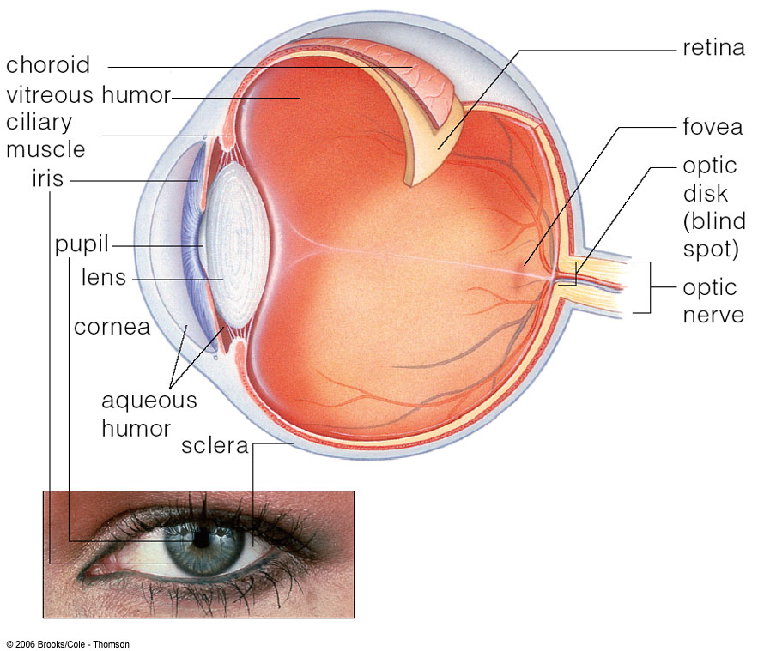
The Eye
Anatomy of eye
Cornea
n≈1.376
blurred vision under water
Pupil
Adjustable aperture
The crystalline lens
Gradient index lens
n=1.406 for inner core
n=1.386 for cortex
Retina
Adjustable receiver
Adjusting time: 15min.

Slide 4
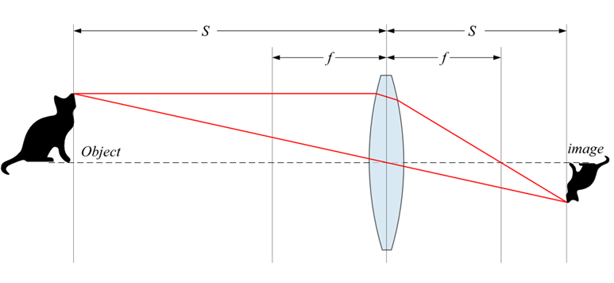
Optical model of eye
Vision comes from that the normal eye focuses light and produces a sharp image
Model: inverted minified image by a thin lens with fixed image distance
o
i

Slide 5
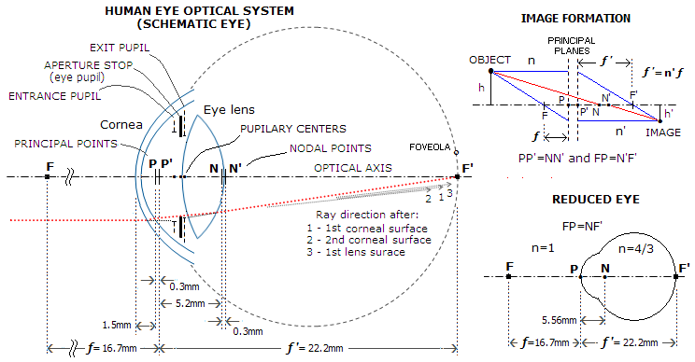
Optical model of eye
Most of the refraction takes place at the outer surface of the eye
Vision is quit poor if eye immerges in the water

Slide 6
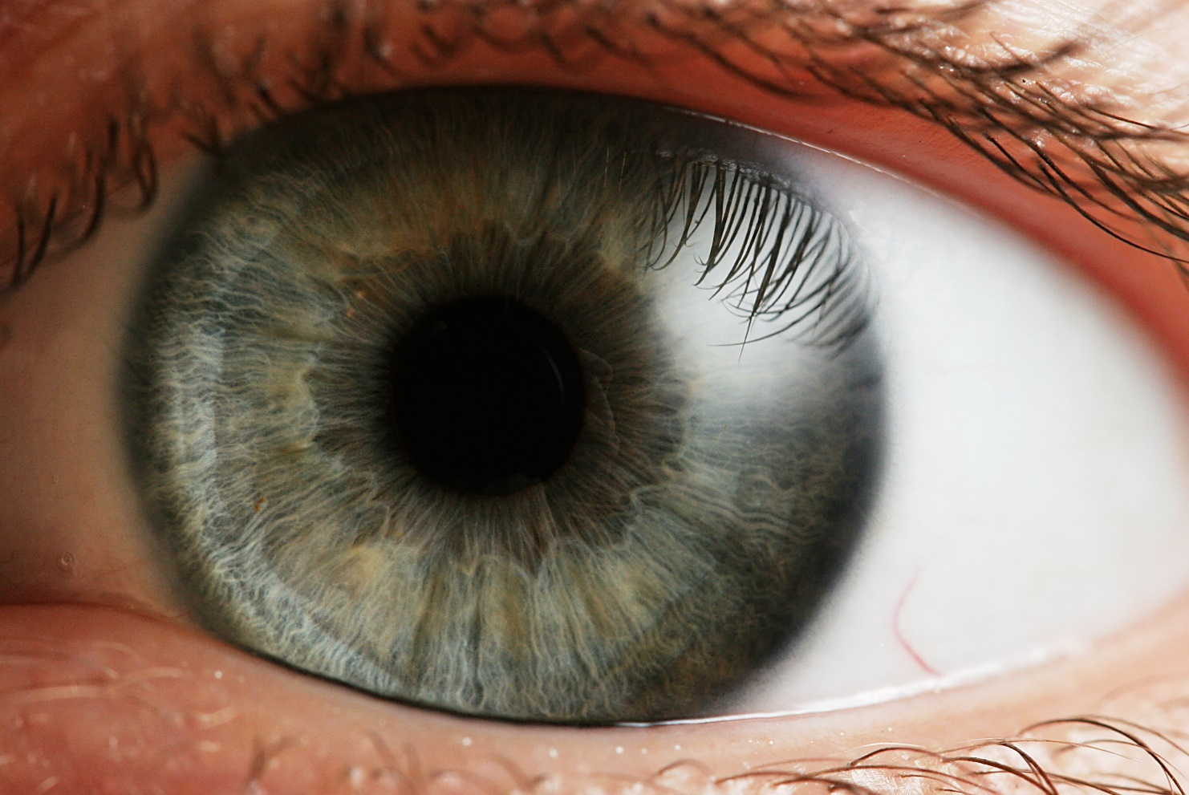
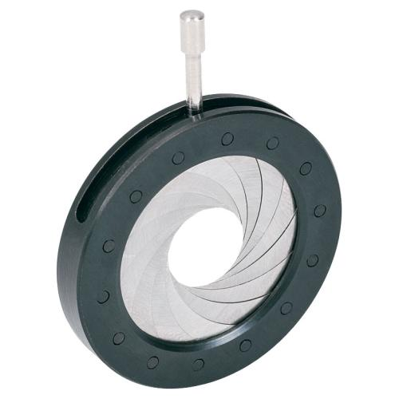
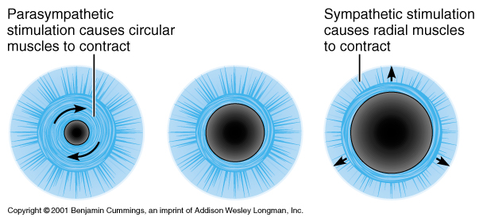
Optical model of eye
The f-number of the eye is from about 2.8 to 16
Pupil diameter is adjustable by iris, about 2mm-10mm

Slide 7
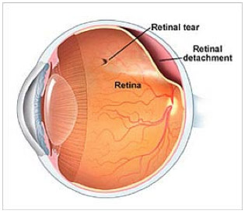
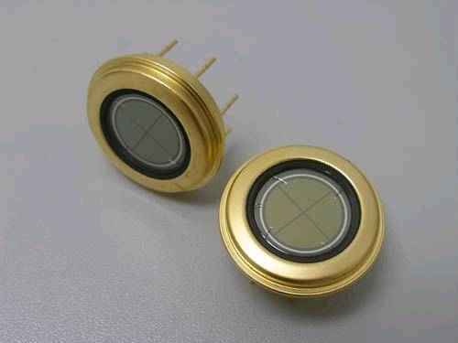
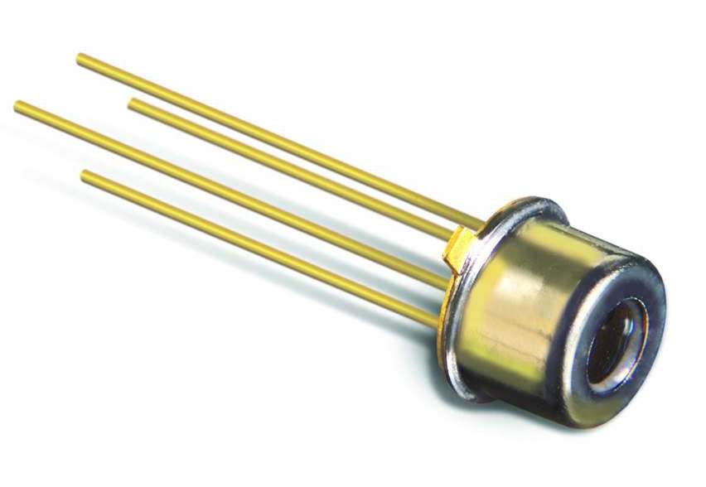
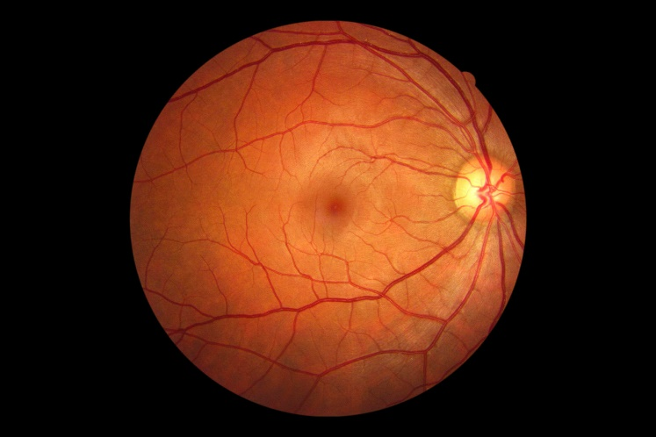
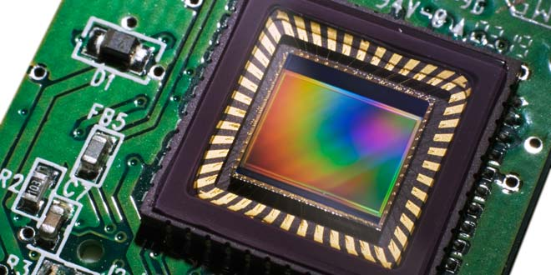
Optical model of eye
Retina, a complex and amazing photoreceptor/photodetector
Avalanche Photodetector
Four Quadrant Photodetector
CCD

Slide 8
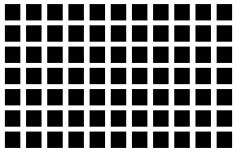
Are you seeing spots? Illusion!

Slide 9
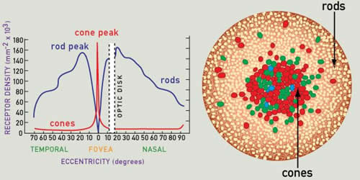
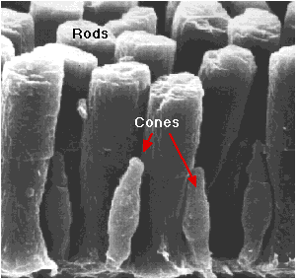
Photoreceptors: Rods & Cones
Rods
Diameter: 2μm
Sensitive to low-light levels (scotopic vision)
Large amount (100-150 million rods)
Low density and therefor low resolution
Black-and-white vision
Cones
Diameter varies from 0.5 to 4.0 µm. Smallest and most tightly packed at the the fovea.
Sensitive to higher-light levels (photopic vision)
Small amount (6-7 million)
High resolution
Detect color by the use of 3 different kinds of cones
Notes:
The fovea defines the center of the retina, and is the region of highest visual acuity. In the fovea there are almost exclusively cones, and they are at their highest density. In Fovea, there are almost no rods.

Slide 10
Comparison between rods and cones
Photoreceptors: Rods & Cones
Rods | Cones
Used for night vision | Used for day vision
Loss causes night blindness | Loss causes legal blindness
Low spatial resolution with higher noise | High spatial resolution with lower noise
Not present in fovea | Concentrated in fovea
Slower time response to light | Quicker time response to light
One type of photosensitive pigment | Three types of photosensitive pigment
Emphasis on motion detection | Emphasis on detecting fine detail

Slide 11
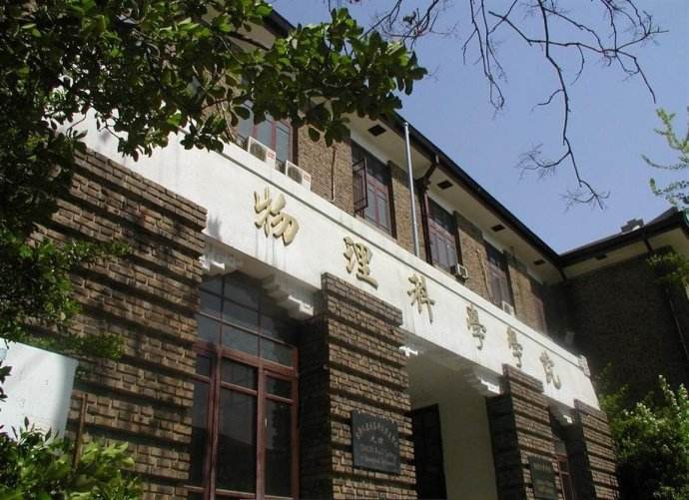
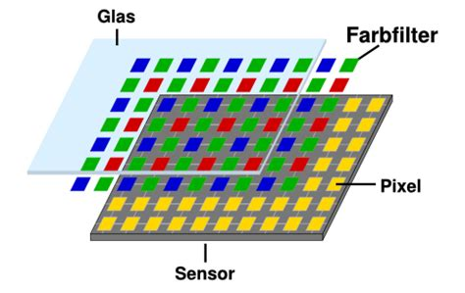
Photoreceptors: Rods & Cones
CCD sensor
Retina and vision. Circles present the rods and cones

Slide 12
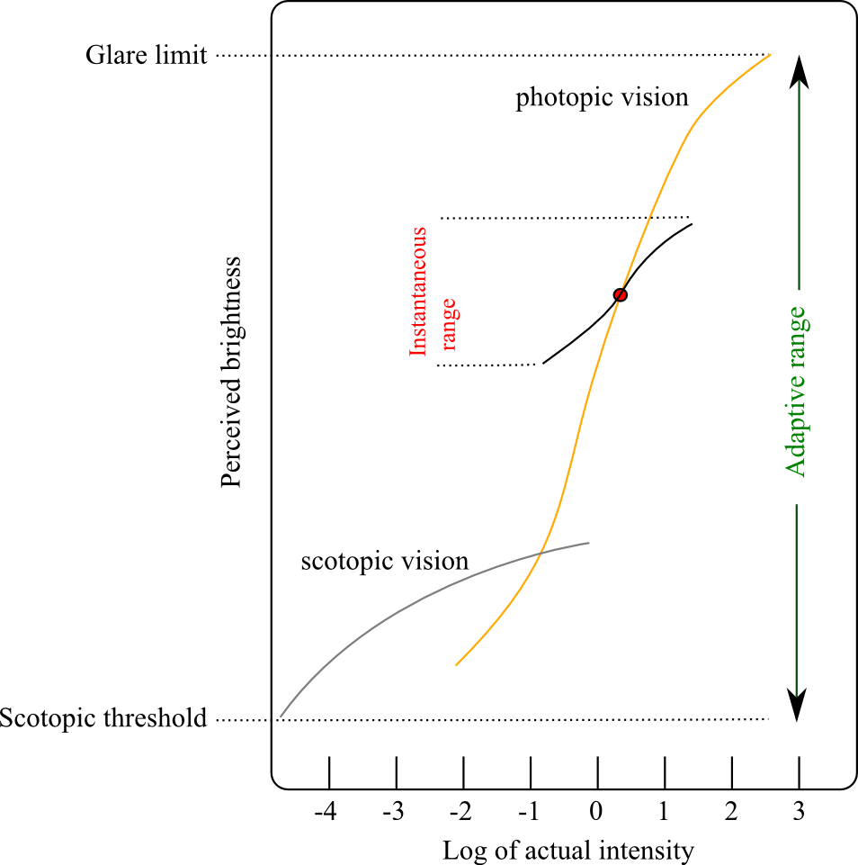
Brightness Adaptation
Intensity is log-compressed for perception.
Human can see light between the glare limit and scotopic threshold with difference on order of 10¹⁰. For sure not all levels at the same time.
The brain/eye find an average value (for example the red dot) of the whole vision and then modulate the sensitivity to make simultaneously vision of all light in a modulated range surrounding the adaptation level.

Slide 13
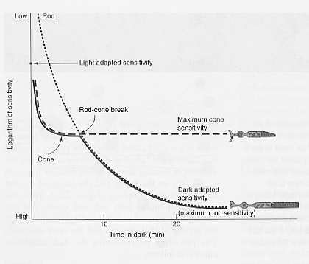
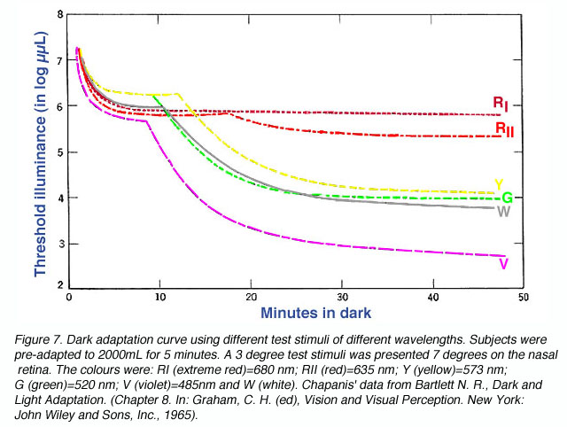
Changeable sensitivity of codes &rods
Switch between codes to rods
Sensitivity and response time:
It takes a bit time for the retina cells to respond to incident light. Codes and rods may switch to work according to the maximum sensitivity of the cells. The sensitivity of the cones and rods changes with time before it gets saturation.

Slide 14
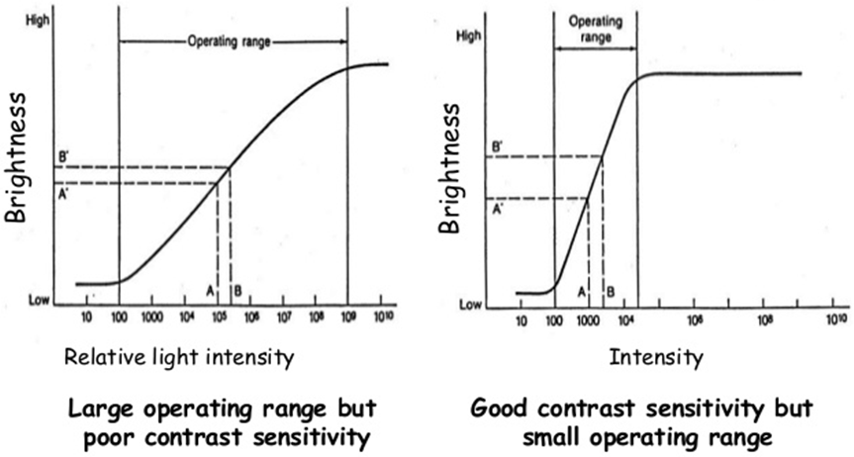
Changeable sensitivity of codes &rods
Benefit of changeable sensitivity: balance between dynamic range and sensitivity
Threshold
Linear response
Saturation

Slide 15
Local Brightness Adaptation and Mach Banding
Local brightness adaptation
When viewing an object, the eye scans across the image while coming to momentary rest at each point of interest.
At each of view points, the eye change its sensitivity to adapts to the average brightness of the local region surrounding the point of interest.
Math banding
A visual effect of LBA of objects with edges where the brightness changes rapidly.
The eye over-/under-shoots at. This causes ‘false perception’ of the intensities

Slide 16
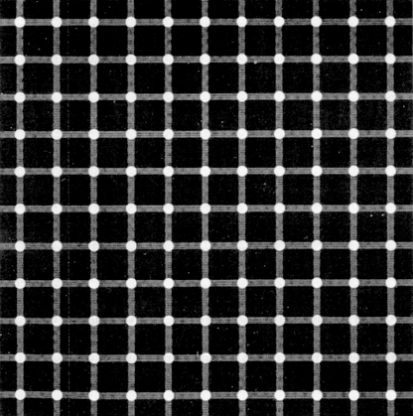
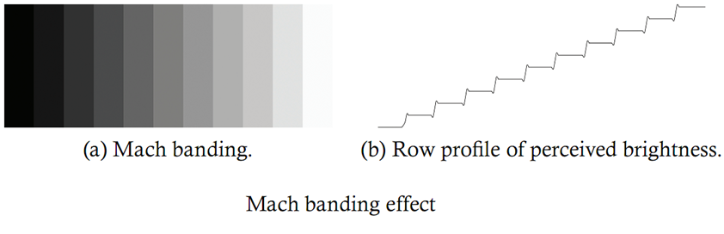
Local Brightness Adaptation and Mach Banding

Slide 17
Color Vision from Cones
Three types of cones
Red (L cone) : 564-580 nm wavelengths (65% of all cones)
Green (M cone) : 534-545 nm wavelengths (30% of all cones)
Blue (S cone) : 420-440 nm wavelengths (5% of all cones)
Type of Cone | Range of Sensitivity | Peak Sensitivity | Color
Short (S) | 400-500 nm | 420-440 nm | Blue
Medium (M) | 450-630 nm | 534-545 nm | Green
Long (L) | 500-700 nm | 564-580 nm | Red

Slide 18
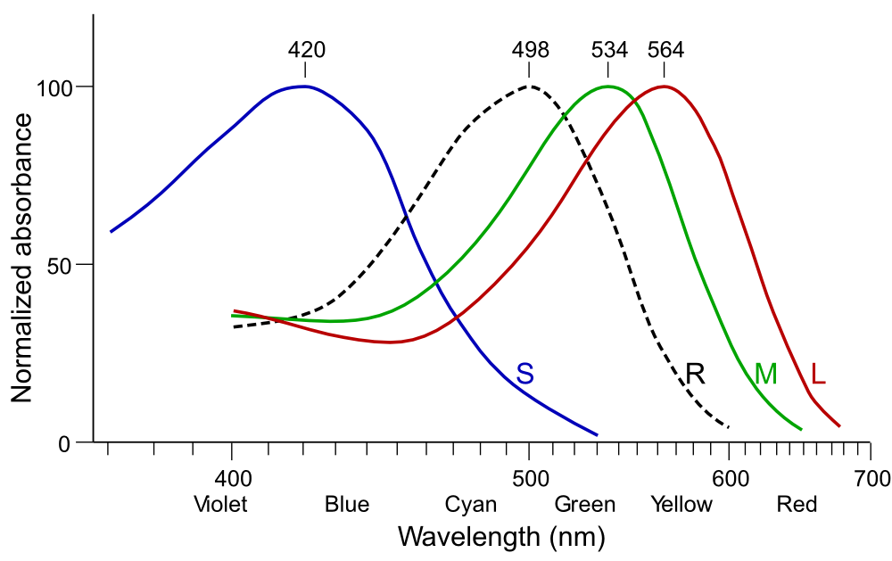
Color Vision from Cones
Type of Cone | Range of Sensitivity | Peak Sensitivity | Color
Short (S) | 400-500 nm | 420-440 nm | Blue
Medium (M) | 450-630 nm | 534-545 nm | Green
Long (L) | 500-700 nm | 564-580 nm | Red
Response of S, M and L cones (blue, green and red lines in the picture.) Black line is the response of rods for night (scotopic) vision with peak about 500nm.

Slide 19
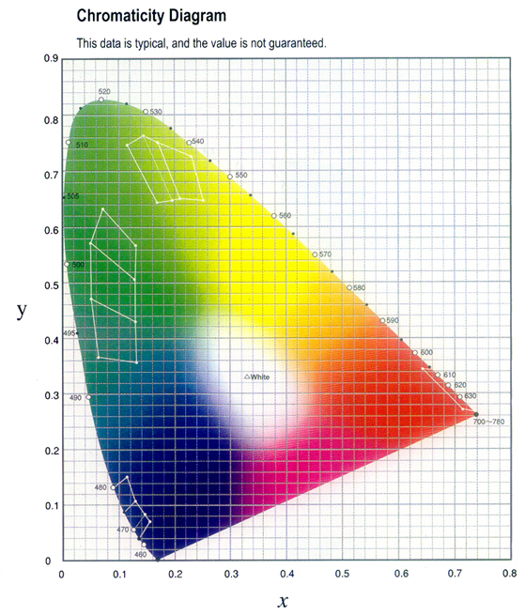
Chromaticity Diagram
This is the diagram used by the CIE to define the chromaticity given chromaticity coordinates x and y. Given a coordinate, one can find the corresponding color in the diagram.

Slide 20
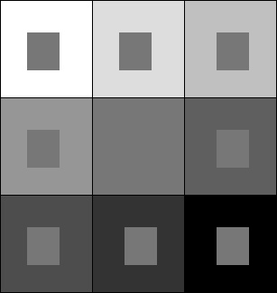
Simultaneous Contrast
Simultaneous contrast refers to the way in which two adjacent intensities (or colors) affect each other.
Example: The nine identical inner squares are surrounded by squares with difference intensity. The perceived intensity of the inner squares varies from bright on the left top to dark on the right bottom.

Slide 21
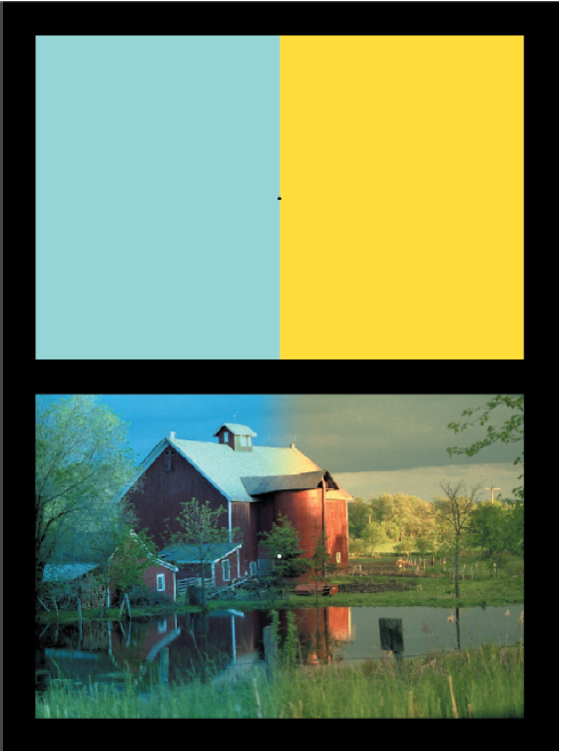
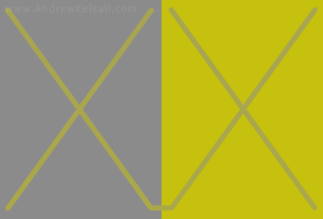
Simultaneous Contrast
Simultaneous Contrast
Identical colors appear to shift when framed by different backgrounds or patterns. This is also called “chromatic adaptation”
The two crosses in fact have identical color.

Slide 22
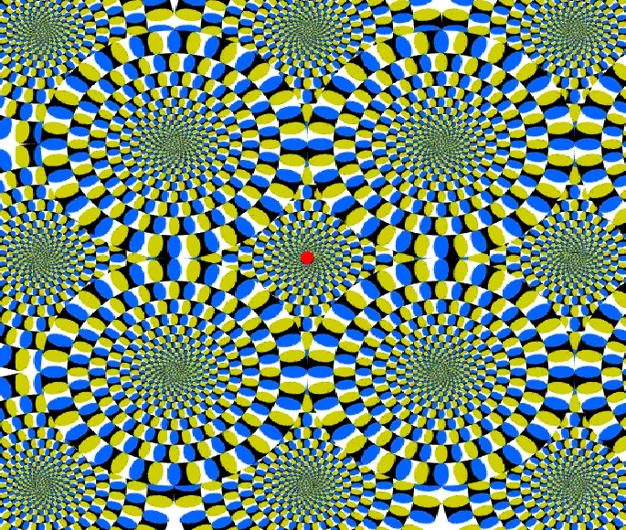
Move your eyes across the image and watch the rotating figures. Then focus your eyes at the red dot in the center and within a few seconds nothing moves.

Slide 23
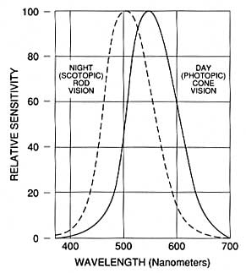
Purkinje Effect
Purkinje Effect.
In dim light, eye is most sensitive to wavelengths around 500 nm because rods work. In bright light, eye is most sensitive to wavelengths around 550 nm when cones are more active. This is the basis for differences in our sensitivities to colors in bright or dim lighting.
Bluish-green object appear brighter in dim light than in bright light and greenish-yellow objects appear brighter in bright light than in dim light.

Slide 24
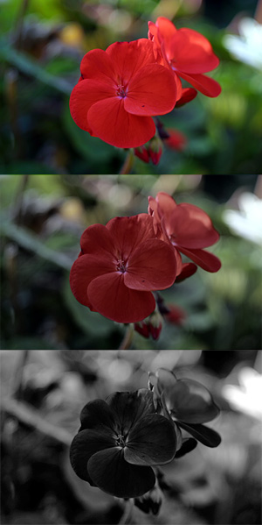
Purkinje Effect
Simulated appearance of a red geranium and foliage in normal bright-light (photopic) vision, dusk (mesopic) vision, and night (scotopic) vision
In daylight the red petals appear brighter and the green leaves duller.
In twilight, the red petals appear duller and the green leaves appear brighter.
Notes:
Figure is from https://en.wikipedia.org/wiki/Purkinje_effect

Slide 25
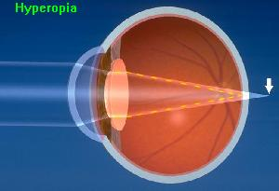
Focusing Problems
HYPEROPIA
Far-sightedness
Problem seeing close objects
Distance between lens and retina too small
Light focused behind retina
Corrected with converging lenses

Slide 26
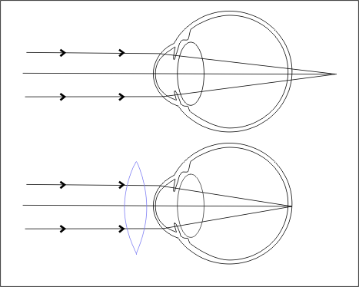
Far-Sighted (Hyperopia) and its correction
Focusing Problems
正常
近点：25cm 远点：∞
远视
近点： > 25cm 远点：∞
矫正：要把近点成像到25cm处

Slide 27


Focusing Problems
PRESBYOPIA
Form of far-sightedness
Harder for people to read as they age
Lens loses elasticity
Corrected by glasses with converging lenses

Slide 28
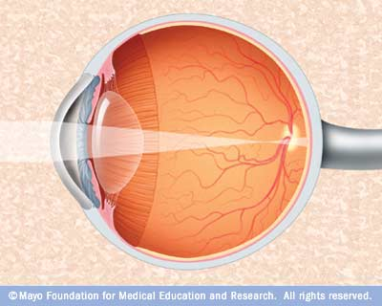
Focusing Problems
MYOPIA
Near-sightedness
Problem seeing objects far away
Distance between lens and retina too large
Light focused in front of retina
Correct with diverging lenses

Slide 29
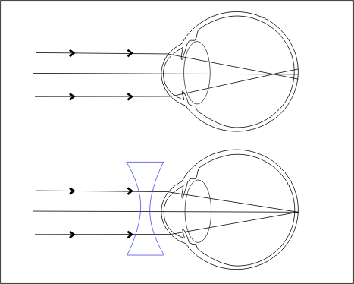
Focusing Problems
正常
近点：25cm 远点：∞
近视
近点： <25cm 远点：有限值
矫正：要把远点成像到无穷远处
Near-Sighted (Myopia) and its correction

Slide 30
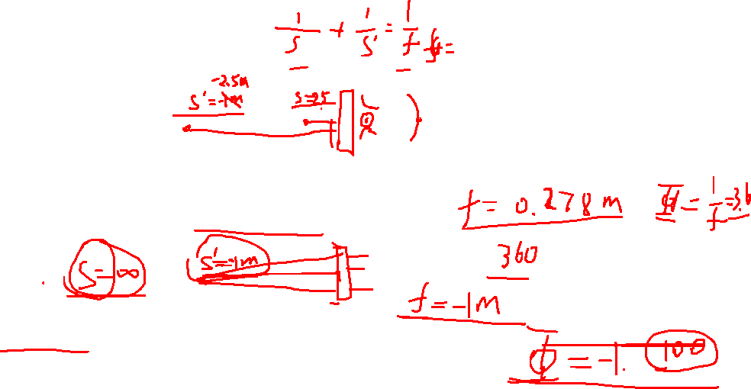
问题
正常
近点：25cm 远点：∞
眼睛度数是多少？
远视
近点：2.5 m 远点：∞
矫正：要把近点成像到25cm处
近视
近点： <25cm 远点：1m
矫正：要把远点成像到无穷远处
Near-Sighted (Myopia) and its correction

Slide 31
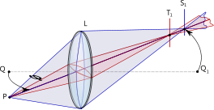
Astigmatism
Astigmatism
The light from a point source produces a line image on the retina. The vision is blurred
Produced when either the cornea or the lens or both are not perfectly symmetric

Slide 32
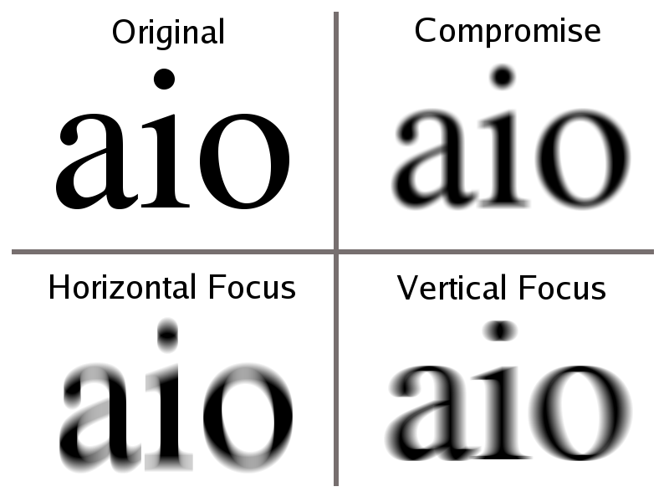
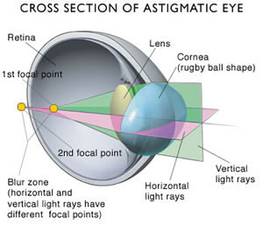
Astigmatism

Slide 33
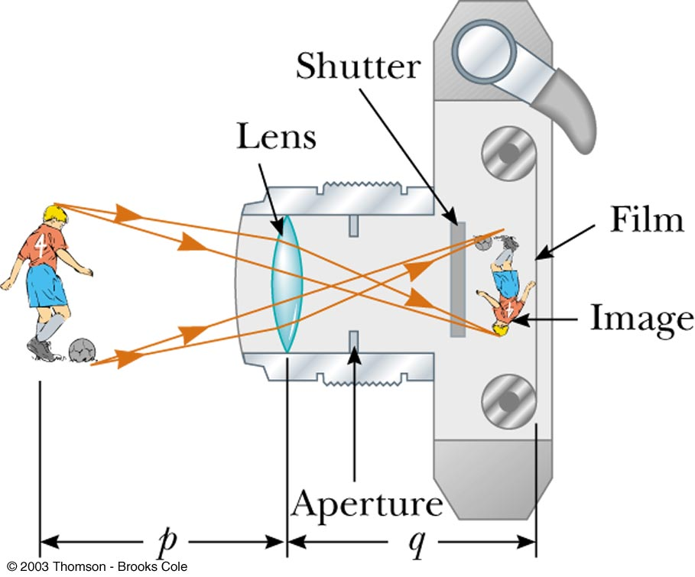
The Camera
The single-lens photo-graphic camera is an optical instrument
Components
Box
Hold components
Converging lens
Form a real image
Shutter
Adjustable Aperture
Film
Receives the image

Slide 34
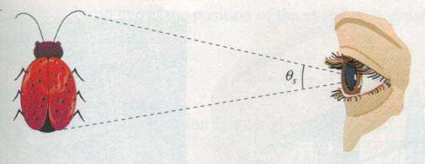
Simple Magnifier
Device to increase the apparent size of an object. It enlarges the subtended angle
h
d
In general the angle is maximum when the object is at the minimum distance, i.e., d=d_{min}~25 cm.

Slide 35
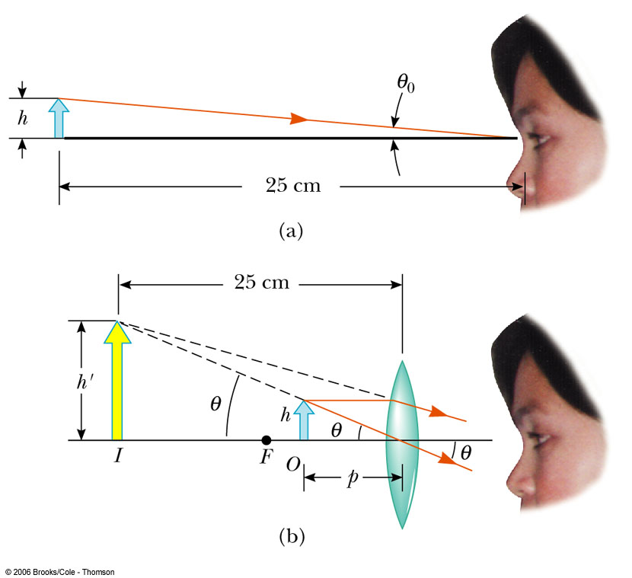
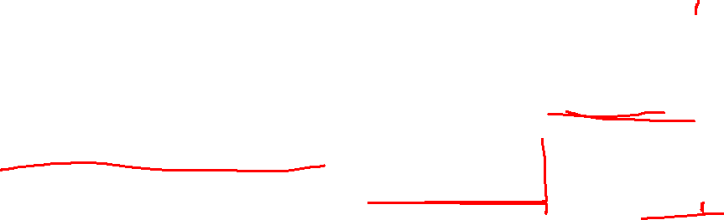
Simple Magnifier
When the object is placed within the focal length of a converging lens, the lens forms a virtual, erect, and enlarged image
Angular magnification

Slide 36
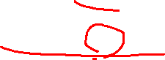
Simple Magnifier
The angular magnification is at a maximum when the image formed by the lens is at the near point of the eye
With a single lens, m may reach 4 without apparent aberrations
With multiple lenses, magnifications of up to about 20 can be achieved. Aberration is corrected by the multiple lenses design.

Slide 37
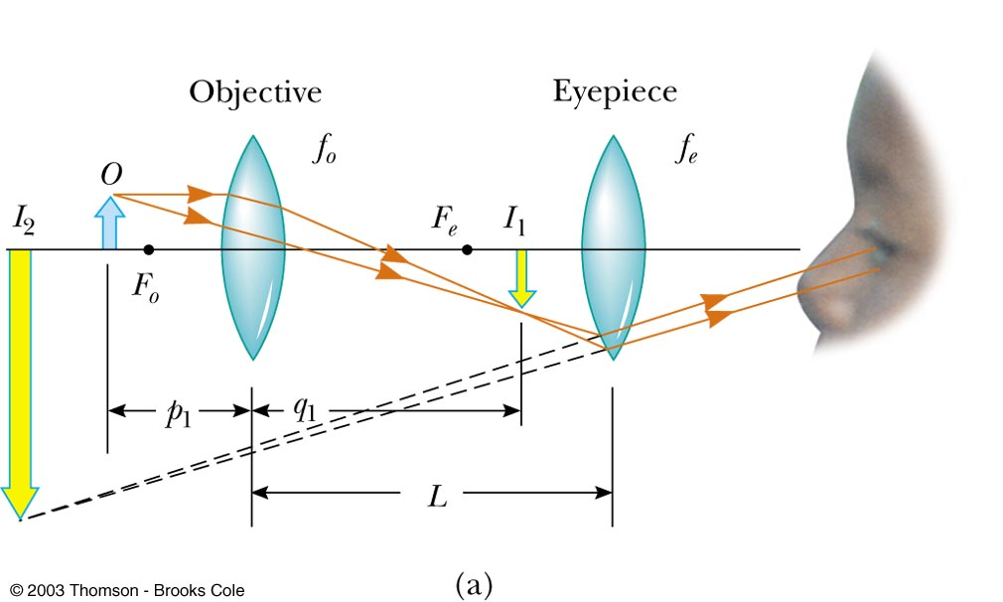
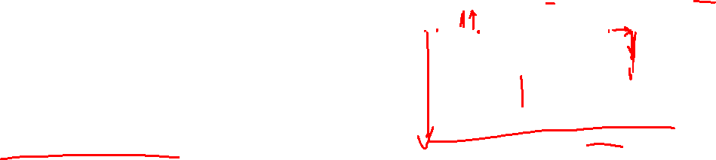
Compound Microscope
Far greater magnification can be achieved by a compound microscope
A compound microscope consists of two lenses separated by distance L
The objective lens has a short focal length, ƒ_{o}<1 cm
The ocular lens (eyepiece) has a focal length, ƒ_{e}, of several cm
L>> ƒ_{o} and ƒ_{e}
Notes:
光学筒长：物镜像方焦点与目镜物方焦点的距离。

Slide 38

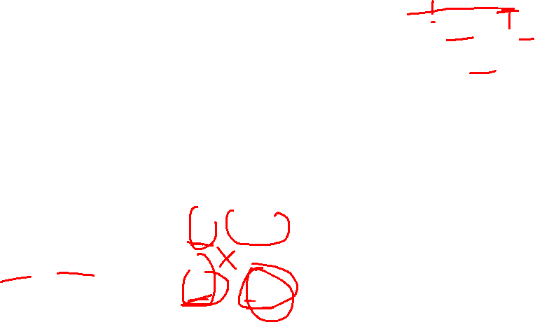
Compound Microscope
The image seen by the eye, I₂, is virtual, inverted and very much enlarged
The magnification of the microscope is the product of the magnifications of the objective and the ocular lens

Slide 39
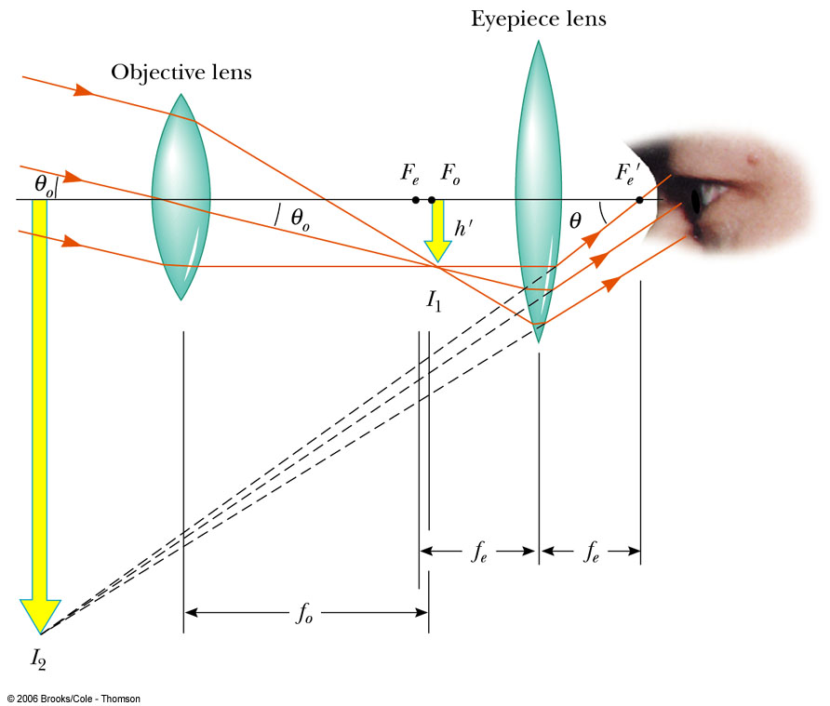
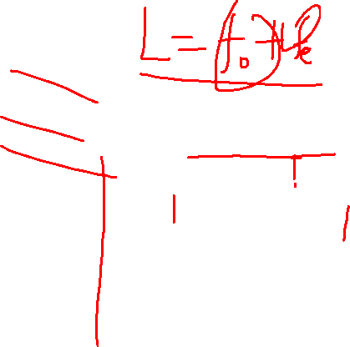
Refracting Telescope
The two lenses are separated by the distance ƒ_{o} + ƒ_{e} which corresponds to the length of the tube
The two lenses are arranged so that the objective forms a real, inverted image of a distant object

Slide 40
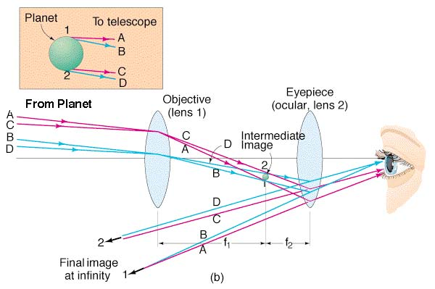
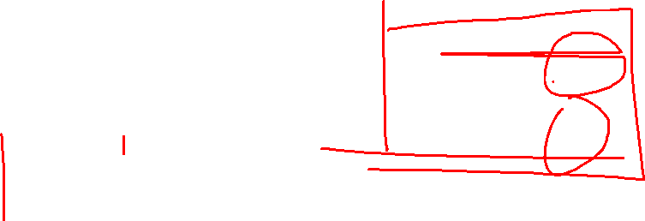
Refracting Telescope
The angular magnification depends on the focal lengths of the objective and eyepiece

Slide 41


Reflecting Telescope
Replaces the objective lens with a mirror

Slide 42
Adaptive optics system

Slide 43



Adaptive optics system
Shack-Hartmann wavefront sensor
Adaptive Optics

Slide 44

Deformable mirrors come in many sizes
Range from 13 to > 900 actuators (degrees of freedom)
About 12”
A couple of inches
Xinetics

Slide 45

Hartman-Shack Aberrometer

Slide 46

Hartman-Shack Aberrometer
For normal eye, parallel beam will be focused by the lenslet into 2-dimensional regular dot array.

Slide 47

Hartman-Shack Aberrometer
If the eye has focusing problem, distorted dot array appears

Slide 48

Hartman-Shack Aberrometer
Focusing problem can be analyzed from the comparison of the two arrays

Slide 49
Aberration

Slide 50
Aberration
First-order theory is no more than a good approximation. An exact ray trace or even measurement performed on a prototype system would certainly reveal inconsistencies with the corresponding paraxial description. Such departures from the idealized conditions of Gaussian optics are known as Aberration

Slide 51
Aberration
Chromatic aberrations
The aberrations arise from the fact that refractive index, n, is actually a function of frequency or color.
Monochromatic aberrations
Monochromatic aberrations occur even with highly monochromatic light.

Slide 52

Chromatic Aberration
White light along the axis are focused at different points on the axis because of the dispersion of lens.

Slide 53


Chromatic Aberration
Notes:
www.canon.com/bctv/faq/chrab.html

Slide 54
Chromatic Aberration
The axial distance between two focal points with certain wavelength difference is called the axial (or longitudinal) chromatic aberration, in short A⋅CA. positive and negative A⋅CA are all possible:
B, Y and R present blue, yellow and red colours.
Notes:
www.canon.com/bctv/faq/chrab.html

Slide 55
Chromatic Aberration
Different wavelength from an off-axial point will focus at a different height above the axis. The vertical distance between two such image points (most often blue and red) is called the lateral chromatic aberration (L⋅CA) or lateral color.
L⋅CA

Slide 56
Achromatic Doublets
Thin achromatic doublet (placed in contact)
Two lenses with different dispersion are bonded together to form a single lens. Consider the focus of 3 colors (blue, yellow and red) by an achromatic:
L₁
L₂
d
d=0

Slide 57
Achromatic Doublets
Notes:
Y, B and R represent yellow, blue and red respectively.

Slide 58

Achromatic Doublets
Abbe number V:
The condition of achromate:
Because V > 0, one lens should be positive lens, and the other should be negative lens.

Slide 59
Achromatic Doublets
Separated achromatic doublet
It is also possible to achromatize a doublet composed of two separate lenses of the same glass . In this case,
where
L₁
L₂
d

Slide 60
Achromatic Doublets
Differentiating the formula of focus length we have:
Differentiating the formula of F, we get:

Slide 61
Achromatic Doublets
For achromatic case, ΔF=0, i.e. blue and red light have the same focal length. So we have,
or:
If the two lenses are made of the same material, V₁=V₂
It is the case for Huygens’ eye-piece.

Slide 62
Monochromatic Aberrations
monochromatic aberrations
Monochromatic aberrations occur even with highly monochromatic light.

Slide 63
Monochromatic Aberrations
If rays from the periphery of a lens are considered in the imaging, the paraxial treatment, sinϕ=ϕ, is not unsatisfied.
Retain the first two terms, we have an improved approximation, third-order theory.

Slide 64
Monochromatic Aberrations
In addition to the first two items, the series obviously contains many other terms, smaller but still to be reckoned with. Thus, there are certainly higher-order aberrations.

Slide 65
Monochromatic Aberrations
Third order aberrations fall into two subgroups:
Spherical aberration(球差), coma(彗差), astigmatism(像散) and so on. They make the image unclear.
Field curvature(像面弯曲), distortion(畸变) and so on. They deform the image.
Notes:
Departures from first-order theory which then result are embodied in the five primary aberrations —— spherical aberration, coma, astigmatism, field curvature and distortion. These were first studied in detail by Ludwig von Seidel (1821-96). Accordingly, they are frequently spoken of as the Seidel aberrations.

Slide 66
Spherical Aberration (SA)
For the paraxial region, conjugate points for a refracting spherical interface are decided by:

Slide 67
Spherical Aberration (SA)
If we take the third-order term into our account, we get the third-order expression:

Slide 68

Spherical Aberration (SA)
The additional term varies approximately as h² and is clearly the deviation from first order theory.

Slide 69
Spherical Aberration (SA)
As the result, ray striking the surface at greater distances above the axis are focused nearer to the vertex.
In briefly, spherical aberration corres-ponds to a dependence of focal length on aperture for nonparaxial rays.
SA will reduce the contrast and degrade the details of image.

Slide 70

Spherical Aberration (SA)
Longitudinal spherical aberratioin, L.SA
The distance between the axial intersection of a ray and the paraxial focus.

Slide 71
Spherical Aberration (SA)
For converging lens, the marginal rays will be focused in front of the in front of the paraxial rays. So its L.SA is positive. In contrast, for a diverging lens, the marginal ray will intersect the axis behind the paraxial focus and its L.SA is therefore negative.

Slide 72
Spherical Aberration (SA)
Transverse (or lateral) spherical aberration, T.SA
The height above the axis where a given ray strikes the focus plane.
Circle of least confusion
When the screen is moved to the position labeled Σ_{LC} the image blur will have its smallest diameter. This is know as the circle of least confusion and Σ_{LC} is generally the best place to observe the image.

Slide 73
Spherical Aberration (SA)
minimize spherical aberration
1. Flat rear side will suffer a minimum amount of spherical aberration.

Slide 74

Spherical Aberration (SA)

Slide 75

Spherical Aberration (SA)

Slide 76

Spherical Aberration (SA)

Slide 77
Spherical Aberration (SA)
minimize spherical aberration
2. Combination of a converging and a diverging lens (as in an achromatic doublet) can diminish spherical aberration.
3. Put the object at S_{o}=2f
4. Use aspherical lenses
5. Use stop
6. ……

Slide 78
Spherical Aberration (SA)
Do we have conjugate points free of spherical aberration?
Yes! We have.
Let first consider single spherical refractive interface. We have three special cases.
n₁
n₂
n₁
n₂
Case 1: rays from
the sphere center
Case 2: rays passing the sphere vertex

Slide 79
Spherical Aberration (SA)
Case 3: Aplanatic points
Recalling the third order imaging formula:
We know there are two conjugation points free from SA, called aplanatic points:
A
h
P'
P
C
V
R
n₁
n₂
Notes:
From refraction law or Fermat’s principle, we have reach the same conclusion of aplanatic points.

Slide 80
Spherical Aberration (SA)
Then question rises: may we use this concept to produce real optical device?
Answer is YES
Typical solution: Locate object P at the center of yellow surface (recall case 1). Its image formed by yellow surface locates at one of the aplanatic points of blue surface (case 3).
A
A
P'
P
C
P'
P
C
R
R
Details may be found in reference named 球面透镜齐明点及其应用.pdf. In fact, aplanatic points are also free from coma and astigmatism because P is on optical axis

Slide 81
Coma
Coma
Coma or comatic aberration associates with an object point even a short distance from the axis. It origins from the fact that the effect focal lengths and therefore the transverse magnification M_{T} differs for rays traversing off-axis regions of lens

Slide 82

Coma
Look at the instance above, the least magnification is associated with the marginal rays which would form the smallest image. We say the coma is negative.

Slide 83

Coma
By comparison, the coma below is positive because the marginal rays focus further from the axis.

Slide 84

Coma
The figure illustrate the formation of the geometrical comatic image of extra-axial object point S. The case corresponds to positive coma. The larger the ring on the lens, the more distance will be its comatic circle from axis.

Slide 85

Coma
Notes:
http://hi.baidu.com/yxfoptics/blog/item/128f333f38cbb0e855e7233c.html

Slide 86
Coma
minimize coma
1. Coma depends on the shape of the lens. A concave positive-meniscus lens with the object at infinity has a large negative coma. When the lens bends to planar-convex, then equi-convex, convex-planar and finally convex meniscus, the coma changes from negative, to zero, to positive. It can be made exactly zero for a single lens with a given object distance. The particular shape it would then have (S_{o}=∞) is almost convex-planar and very nearly the configuration for minimum SA.
Notes:
positive-meniscus lens: ), equi-convex: (), convex meniscus: (

Slide 87
Coma
2. Coma can also be negated by using a stop at the proper location. It was discovered in 1812 by William Hyde Wollaston (1766-1828). While SA is independent of the location along the axis, coma will not, as long as SA is present.

Slide 88

Coma
With the stop at Σ₁, there is SA but no Coma. If the stop is at Σ₂, the symmetry is upset and the coma is positive. With the stop at Σ₃, the coma is negative.

Slide 89
Coma
Optical sine theorem
In any event, it states that:
where n_{o}, y_{o}, α_{o} and n_{i}, y_{i}, α_{i} are the index, height and slope angle of a ray in object and image space , respectively at any aperture size.
Notes:
It is an important relationship in optics. It was discovered independently in 1873 by Abbe and Helmholtz although a different form of it was give ten years earlier by R. Clausius.

Slide 90
Coma
If coma is to be zero,
must be constant for all rays. So we equate the magnification for both marginal and paraxial rays and we get:
It is known as the sine condition. A necessary criterion for the absence of coma is that the system meet the sine condition.

Slide 91

Astigmatism
Astigmatism
When an object is away from the optical axis, the incident rays is no longer symmetrical.
Meridional (tangential) plane:
A plane containing the optical axis and the object points.
Sagittal plane:
The plane contains the chief ray and is perpendicular to the meridional plane.
Notes:
Sagittal plane，极矢面，矢状面。Meridional (tangential) plane，子午面。

Slide 92

Astigmatism
Astigmatism

Slide 93



Astigmatism
Object
Meridional focus
Sagittal focus

Slide 94

Field curvature
Field curvature
Δx

Slide 95
Field curvature
The displacement Δx of an image point at height y_{i} on the Petzval surface from the paraxial image plane is given by
Δx
where n_{j} and f_{j} are the indices and the focal lengths of the m thin lenses forming the system.

Slide 96
Field curvature
For the simple case, a doublet composed by two lens, field curvature negate provided Δx=0 or
Equivalently
Δx
It is called Petzval condition

Slide 97


Distortion
The transverse magnification M_{T} is a function of the off-axis image distance y_{i}. Different ares of the lens have the different focus length and therefore different magnification.
Positive or
Pincushion Distortion
Negative or
Barrel
Distortion

Slide 98
Seidel coefficients
Notes:
B为球面像差（球差）系数，F为彗差系数，C为像散系数，D为像场弯曲（场曲）系数，E为畸变系数。参见波恩的《光学原理》

